Slide 1

Recycling and Illegal Dumping Fund Grants
Joan M. Snider
Outreach Section Manager
Solid Waste Bureau, New Mexico Environment Department

Slide 2
Recycling and Illegal Dumping Act
To prevent and abate illegal dumpsites
To promote reuse and recycling
To foster sustainable use of resources
To create a cleaner and healthier environment
Notes:
Passed in 2005

Slide 3
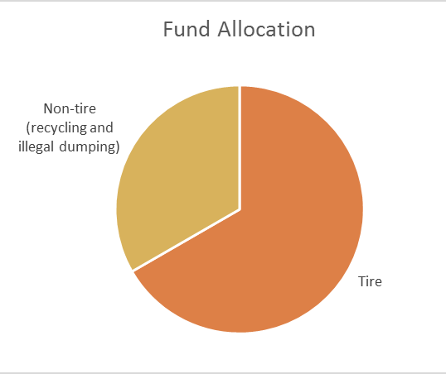
Recycling and Illegal Dumping Fund
50 cents from each motor vehicle registration
$750,000 to $1 million per year
Scrap tire projects receive 2/3 of funds
Awarded since 2006:
  308 grants
  $9.1 million

Slide 4
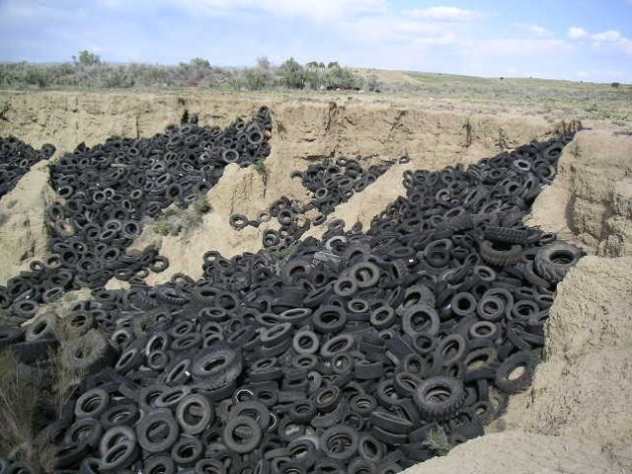
197 Dumpsites Abated

Slide 5
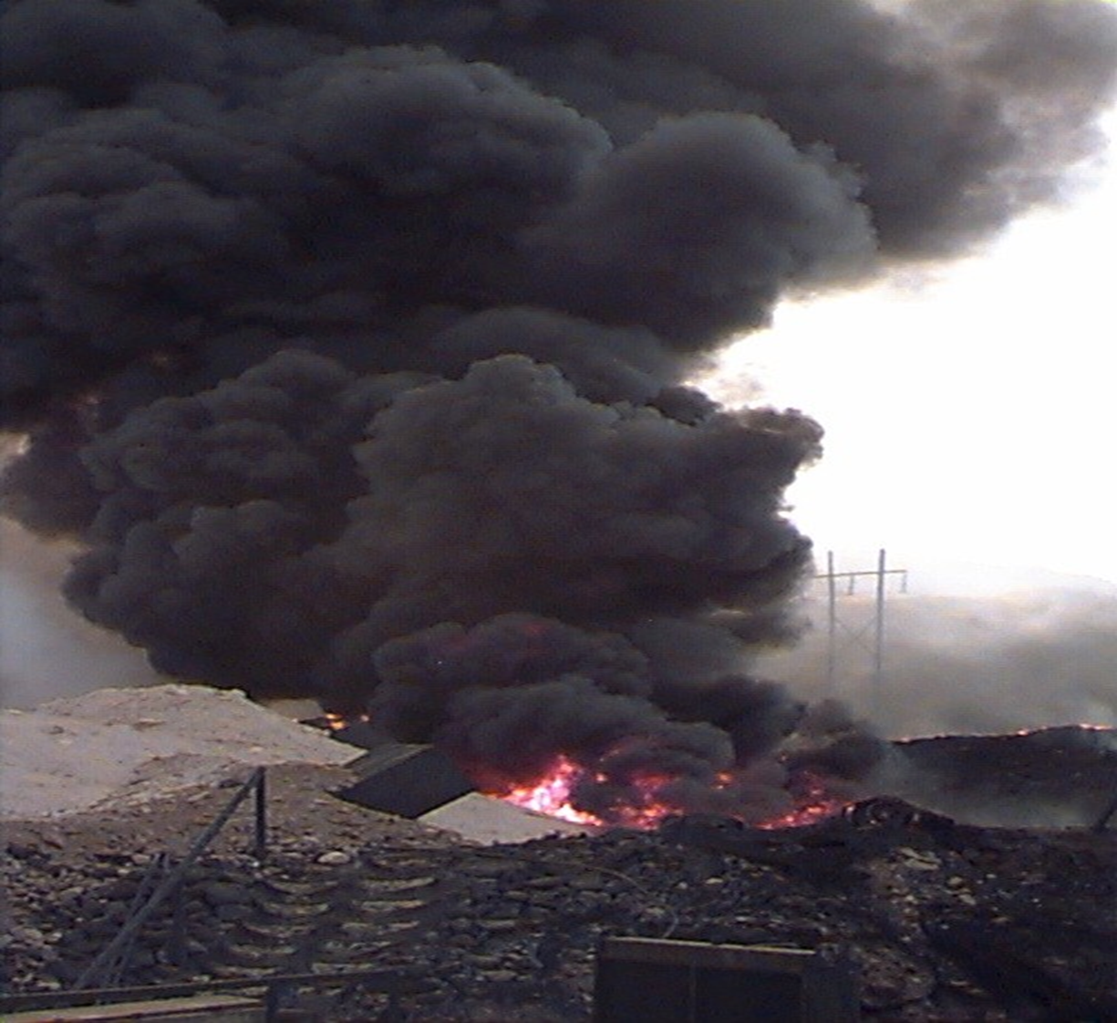

Slide 6
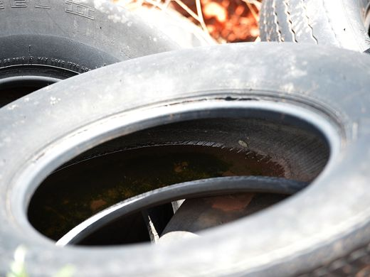

Slide 7
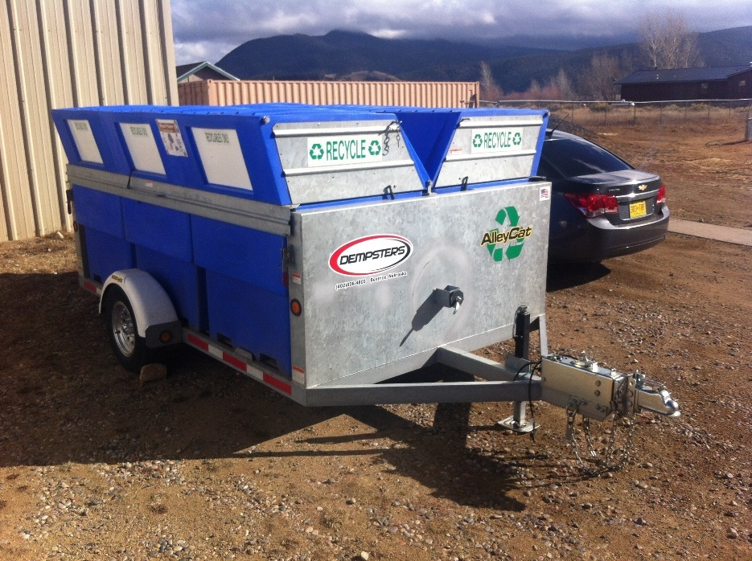
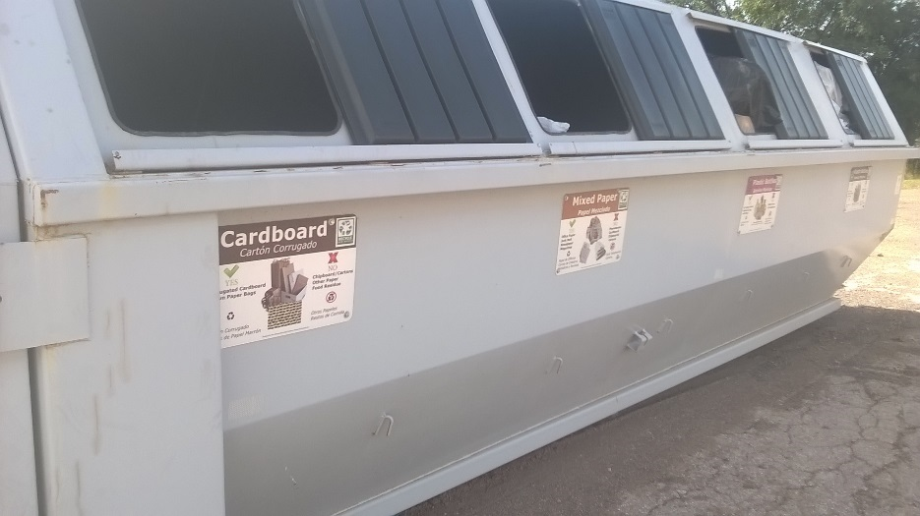
141 Trailers and Roll-Off Containers

Slide 8
Eligible Entities
Municipalities
Counties
Pueblos, Tribes, Nations
Solid waste authorities
Land grant communities
Cooperative associations

Slide 9
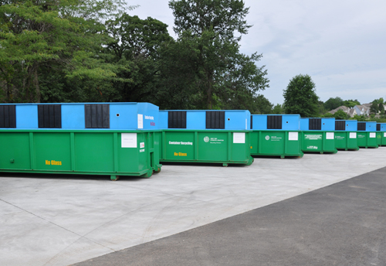
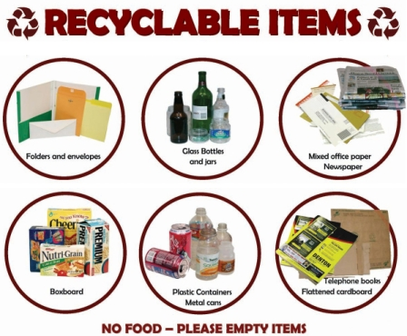
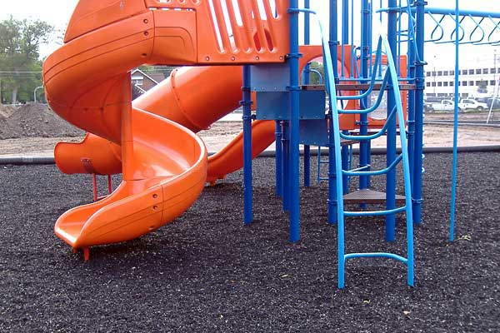
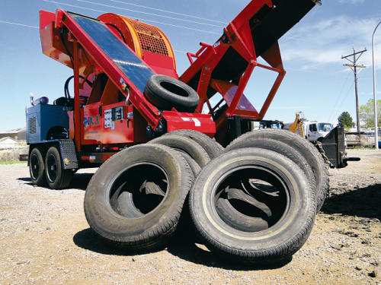
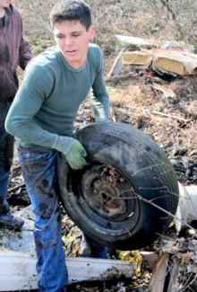
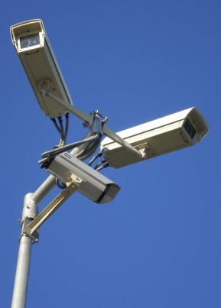
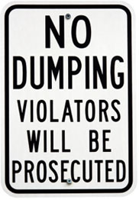
Eligible Expenses
Recycling Infrastructure
Education/Outreach
Stimulating Recycling Markets
Scrap Tire Management
Illegal Dump Cleanup and Prevention
Notes:
Ineligible expenses:
Operating costs
Expenses associated with a corrective action
Remediation costs for which an organization is already liable
Internal expenses such as staff salaries or internal copying/printing services (a.k.a. I.D.C.)
Preparation of the grant application
Processing of recyclables which uses less than 95% of recyclable materials from sources in NM
Purchase of used equipment without a warranty, service agreement, or third-party appraisal and inspection
Litter clean-up
Hand fed chippers for green waste
The tear-down and removal of structures without condemnation
The tear-down and removal of mobile homes
Dumpsite/tire abatement at private businesses and private properties that have received money to manage their waste

Slide 10
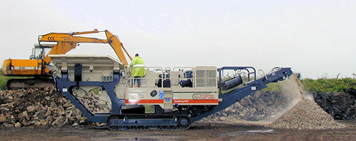
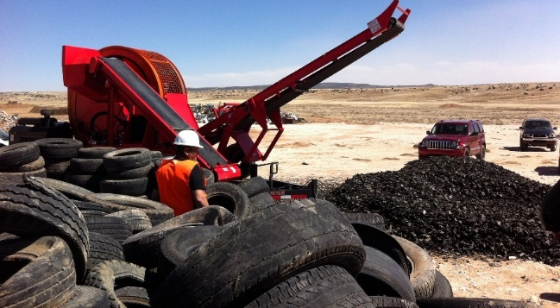
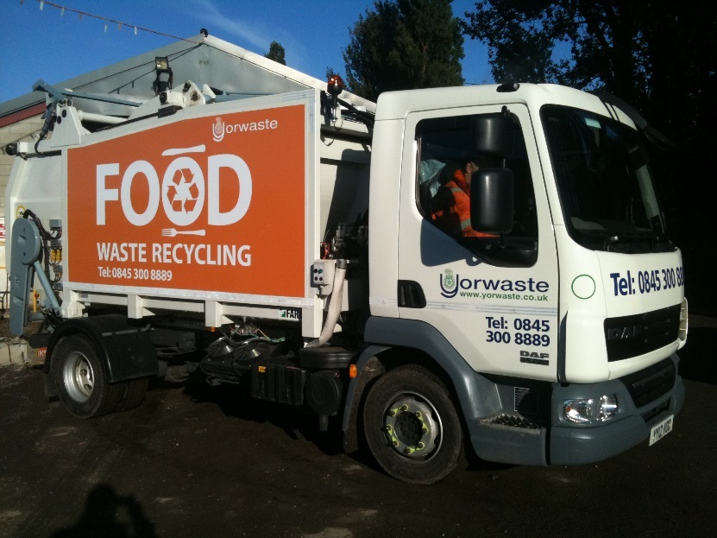
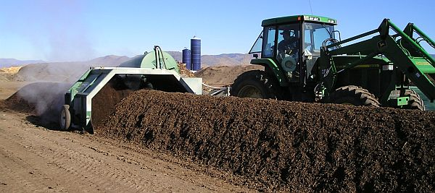
Recycling includes …

Slide 11
Funding
Reimbursement based
Within one fiscal year
No in-kind contributions or matching funds required
Goods and services only
Gross receipts tax eligible

Slide 12
Application Process
Application period: Annually (February-March 2019)
www.env.nm.gov/solid-waste/grant-programs/
RAID Alliance scores applications according to
  Project merit
  Consistency with priorities stipulated in rules
Notes:
Announcements are sent out to:
New Mexico Recycling Coalition
Solid Waste Management Association of North America New Mexico Chapter
New Mexico Association of Counties
Eight Northern Indian Pueblos Council, Inc.

Slide 13
Recycling and Illegal Dumping Alliance
Appointed by NMED Cabinet Secretary for 2-year terms
Composed of one member from
*now accepting letters of interest
  State government *
  Local government
  Solid waste authority
  Industry waste generator *
  Tribal government
  Nonprofit organization *
  Public at large
  Recycling company *
  Retailer *
  Agricultural producer
  Solid and water conservation district
  Waste management company

Slide 14
Priorities
Dumpsite abatement applications are prioritized by
  Number of tires and amount/type of other waste
  Population within a five-mile radius
  Schools, hospitals, businesses and industries within a five-mile radius
  Distance to waterways
  Fire hazard
  If dumpsite is still active and what action, if any, is being taken to abate it

Slide 15
Priorities
Other applications are prioritized by
  Need
  Urgency
  Amount of local funding available
  Consistency with surrounding land use
  Population served
  Consistency with department priorities
  Alternative solutions available

Slide 16
Applications Awarded for FY19
Requested Funds Awarded for FY19
Awarded
Not Awarded

Slide 17
Notable FY17 RAID Grants
De Baca County
San Felipe Pueblo
$76,000
Horizontal baler at transfer station
Two roll-off containers for schools
$75,000
Hauling 19,000 tires from 11 stockpiles and dumpsites to a tire recycling facility
Educational material about tires

Slide 18
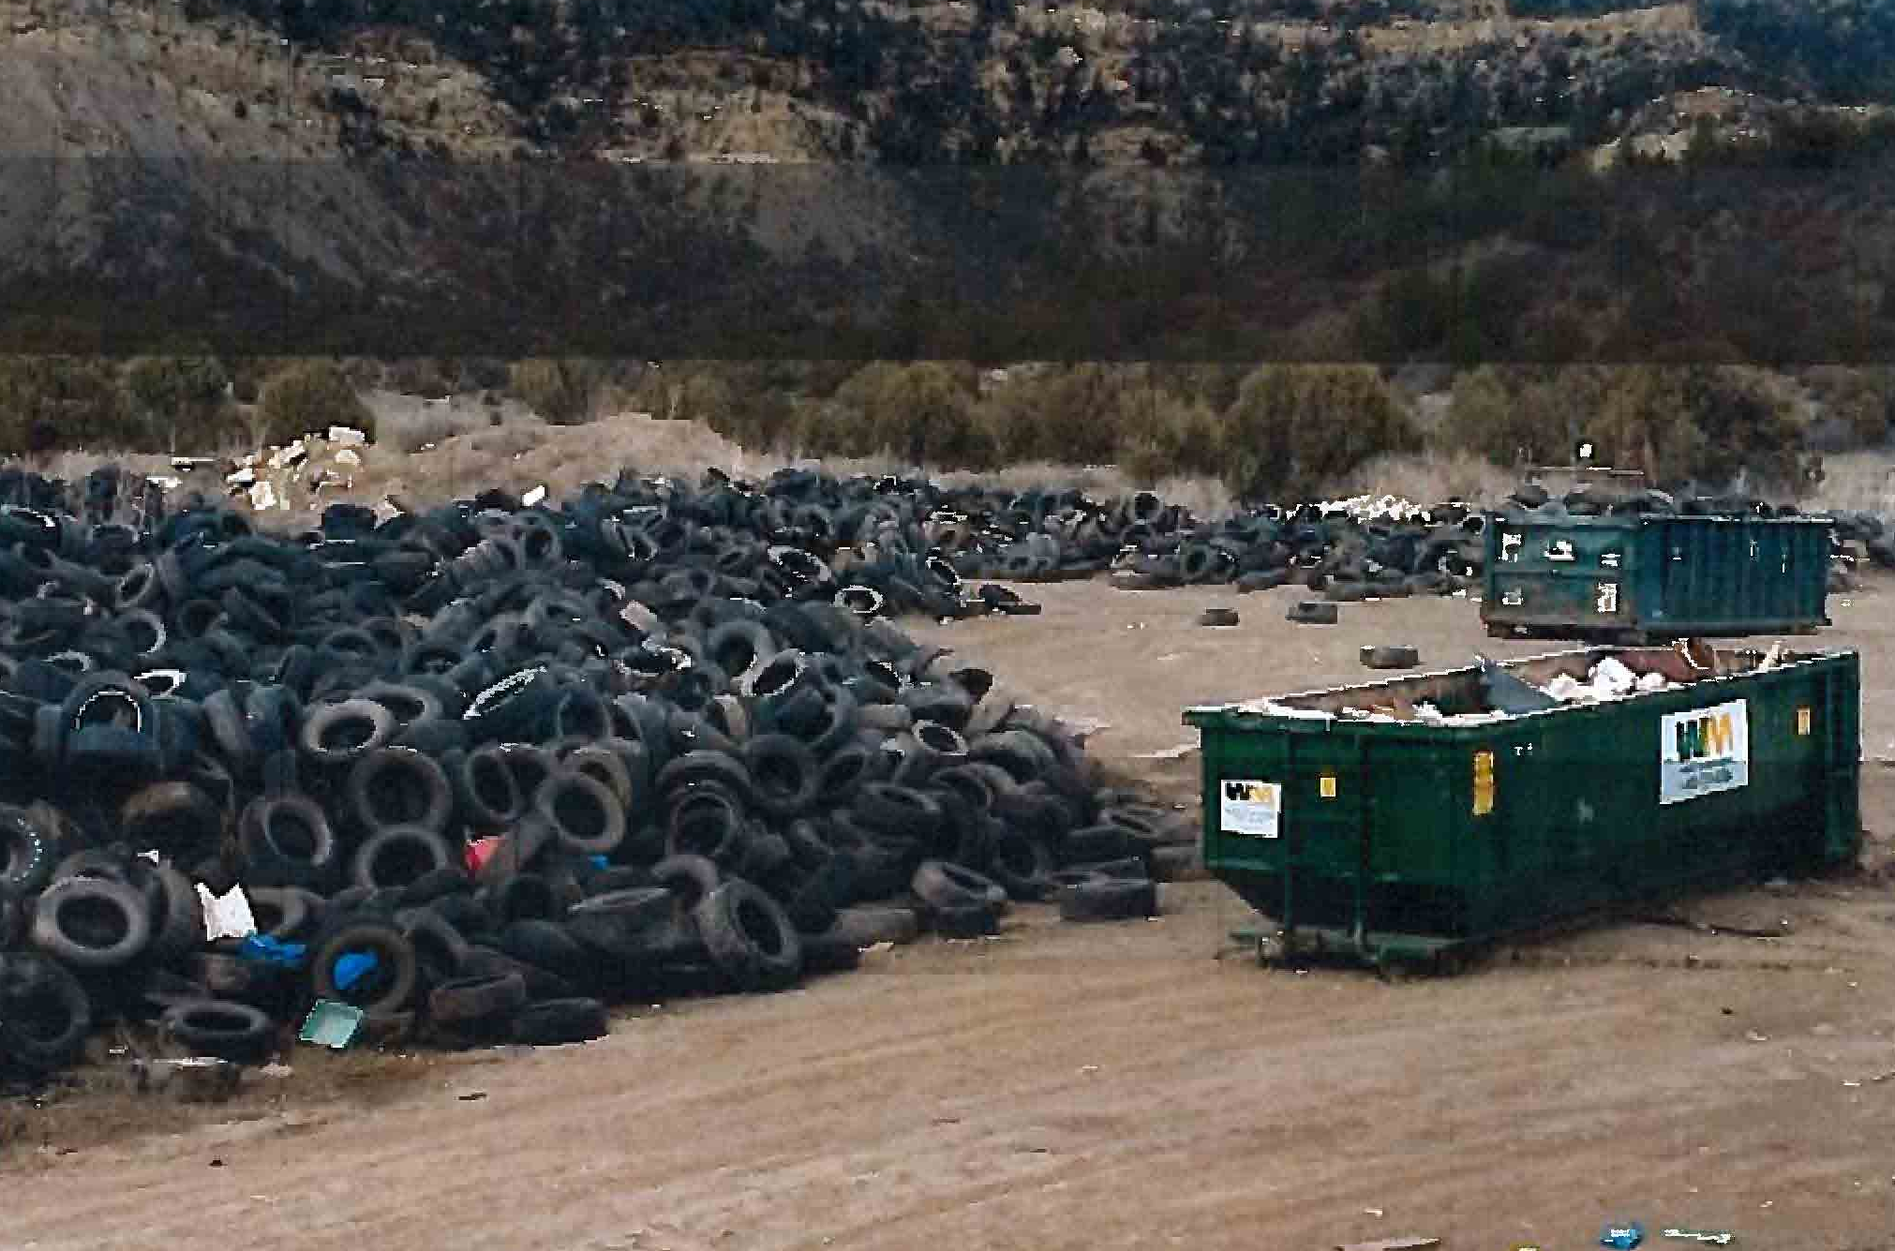
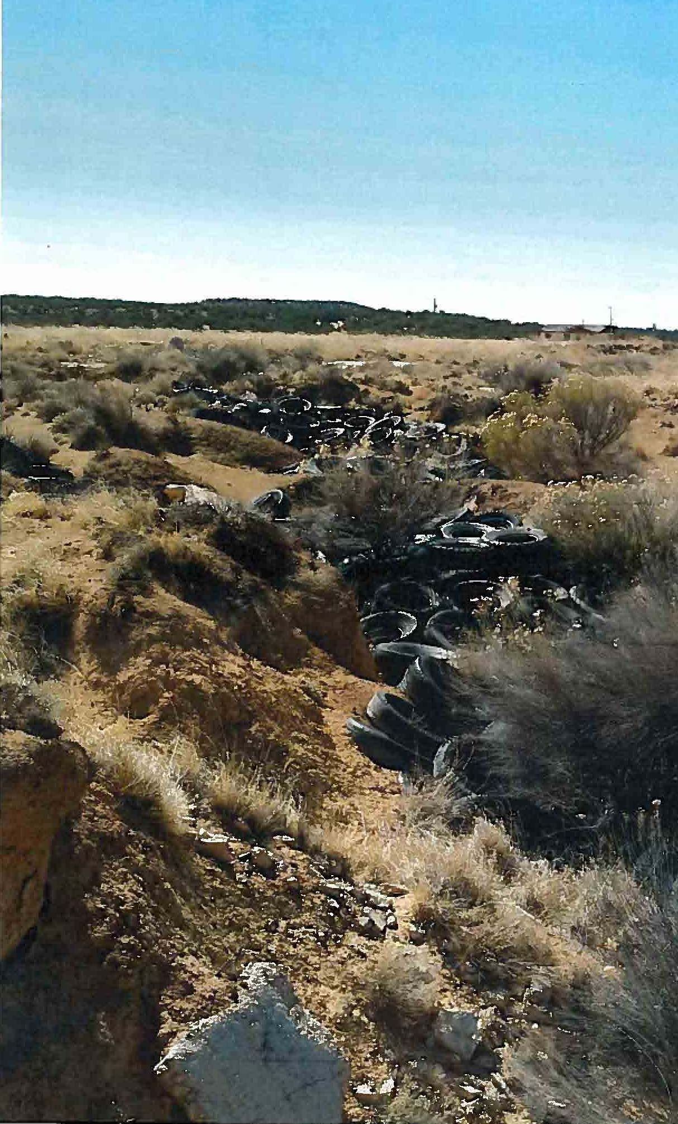

Slide 19
Notable FY17 Grants
Pueblo of Santa Ana
Village of Santa Clara
$36,000
Windrow turner
To compost waste from thinning 120 acres of Rio Grande Bosque, food waste from casinos, and manure
$230,000
Pour-in-place crumb rubber made from recycled tires at new splash park and existing park

Slide 20
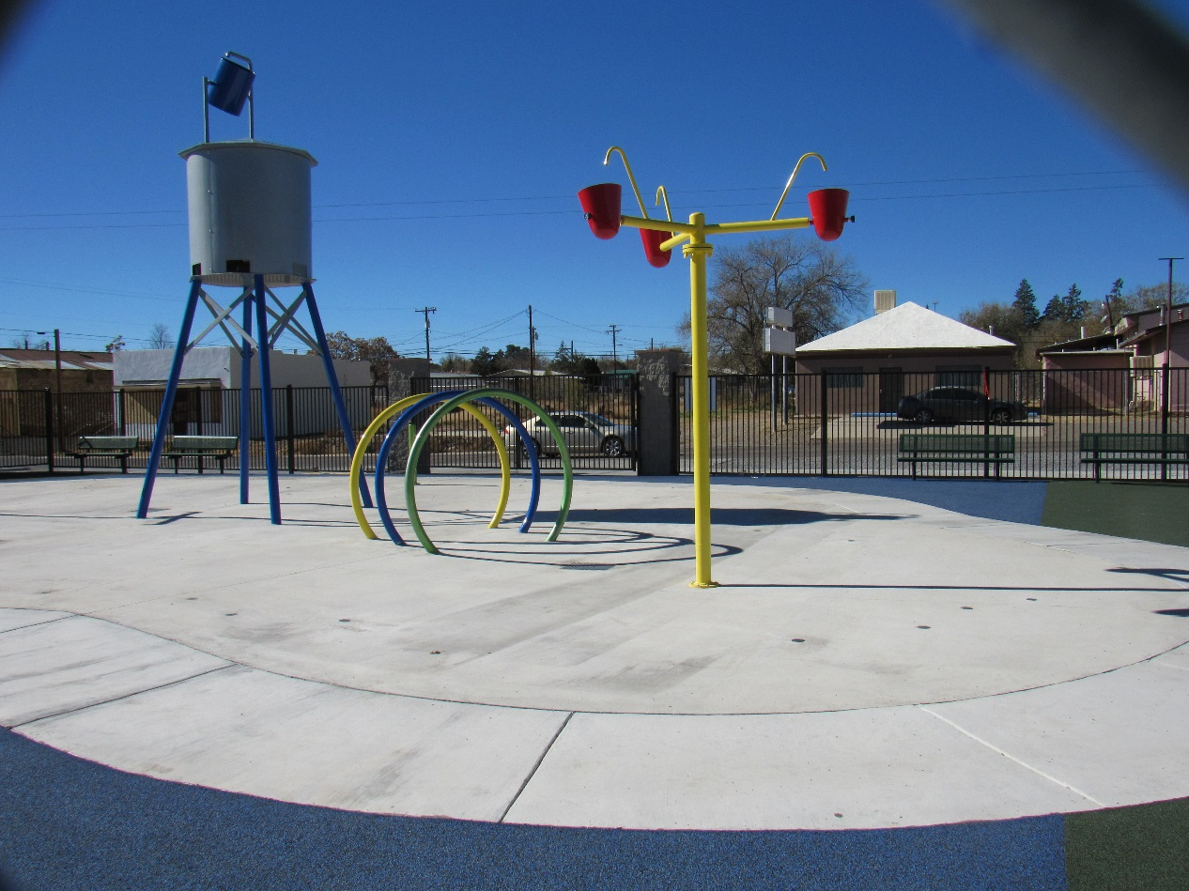
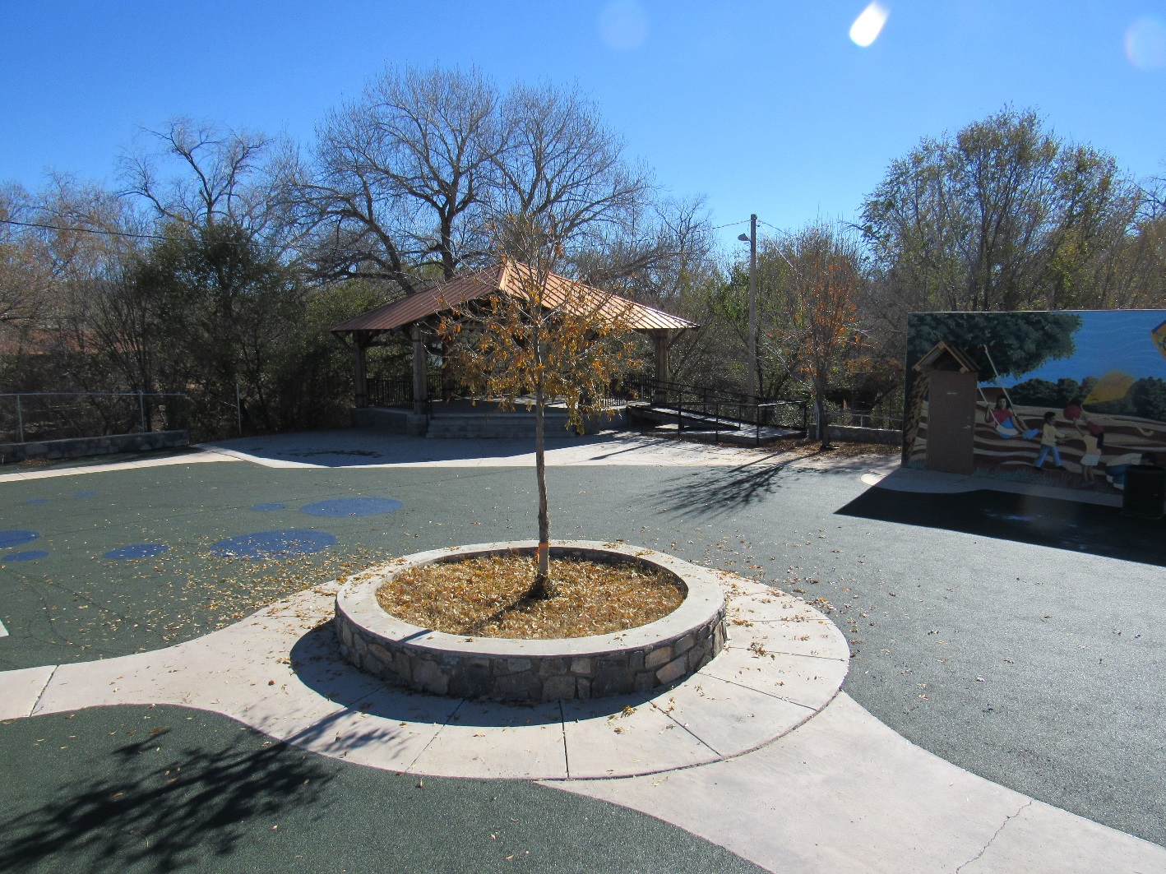

Slide 21
Contact Information
Joan M. Snider
Outreach Section Manager
(505) 827-2780
JoanM.Snider@state.nm.us
New Mexico Environment Department
Solid Waste Bureau
www.env.nm.gov/solid-waste/

Slide 22
Contact Information
Genevieve Morgan
Outreach Specialist
505-827-0129
Genevieve.Morgan@state.nm.us
Melissa Maggass
Outreach Specialist
505-827-2828
Melissa.Maggass@state.nm.us

