Slide 1
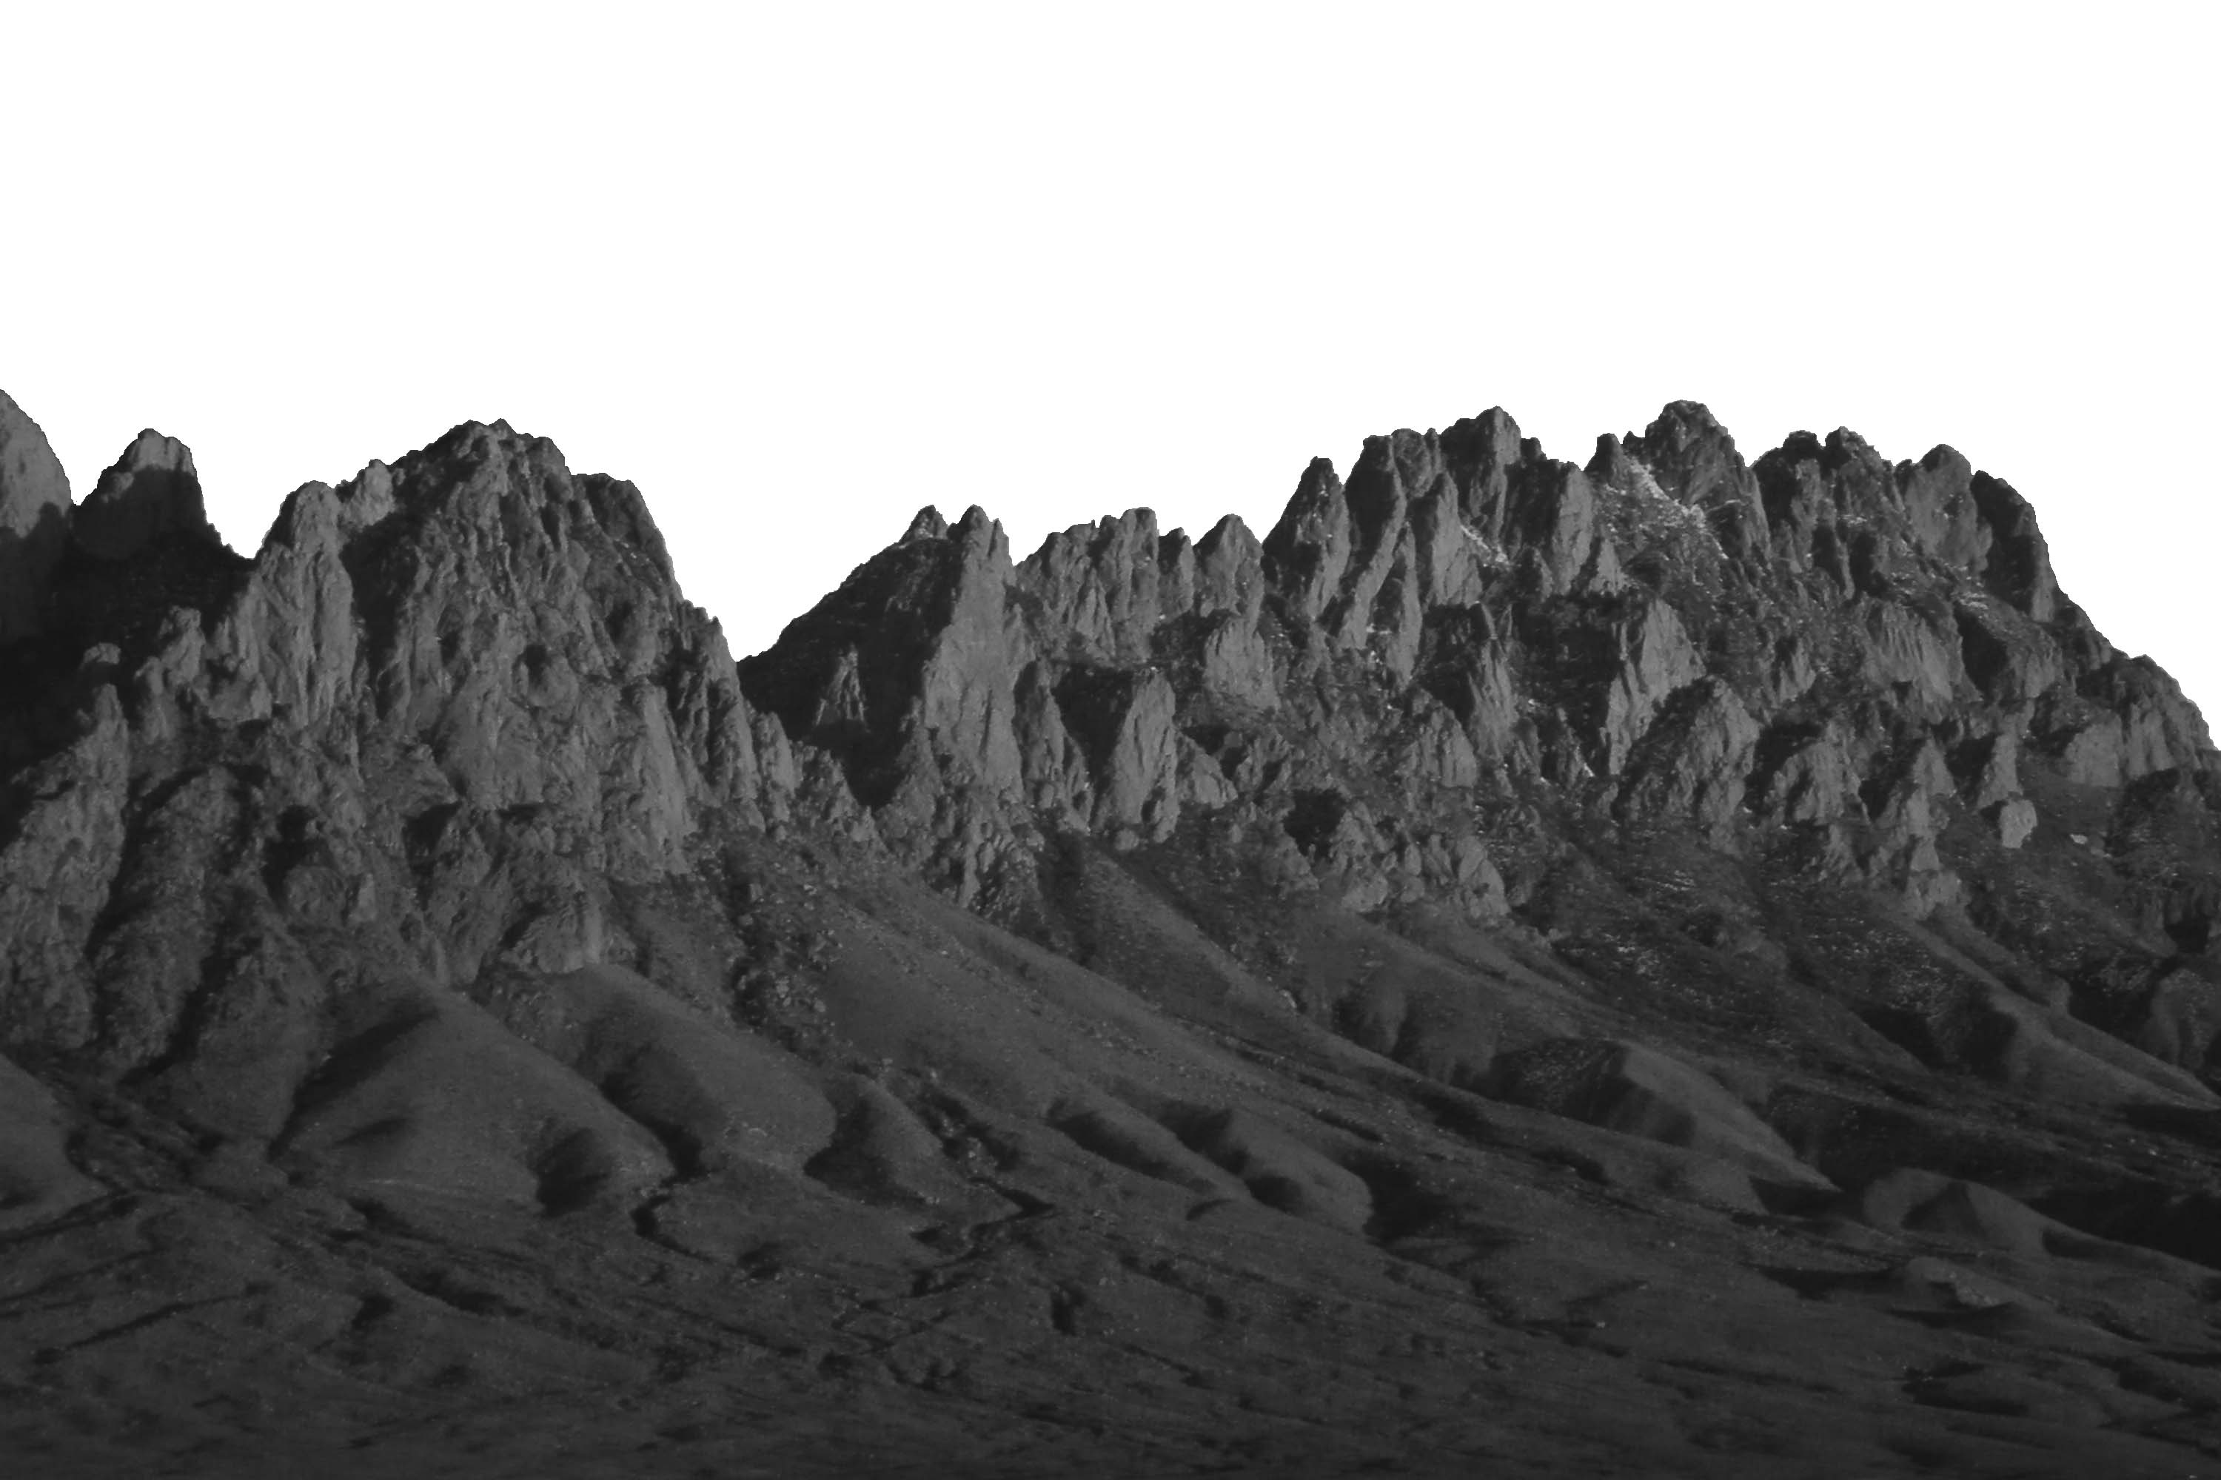
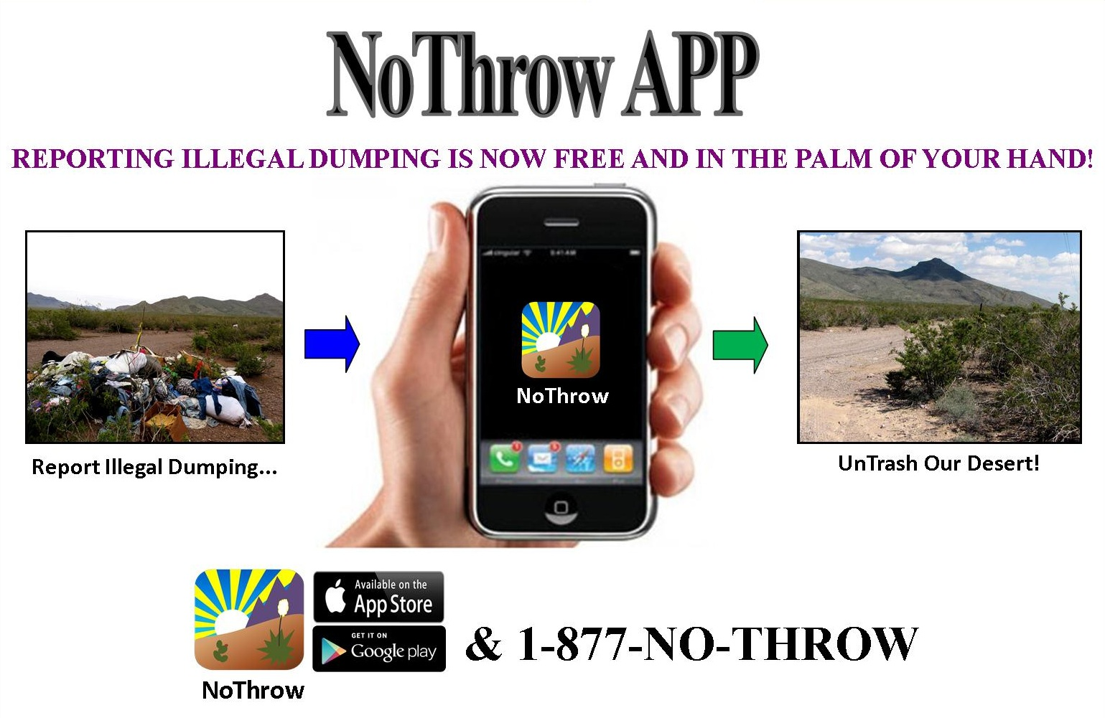
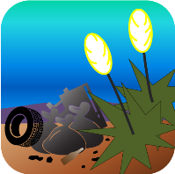
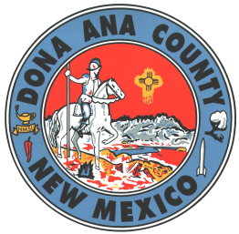


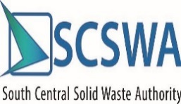
Notes:
Title Page

Slide 2
Vision and Implementation
  Due to the overwhelming amount of trash dumped illegally within Doña Ana County, even after several clean-up efforts, the Illegal Dumping Partnership members were unable to keep up with the sheer amount of trash and a means to map these areas, new reporting mechanisms were needed.
Notes:
Text Slide

Slide 3
“NoThrow App” History
The Original version of the NoThrow App was developed from Bureau of Land Management (BLM) funding through a contract with an New Mexico State University (NMSU) student start-up company, Byteware, LLC. The NoThrow App proved to be a successful application as several reports of illegal dumping locations were being reported on a consistent basis, which allowed the IDP members to track, investigate and remediate sites soon after.
Because the IDP wanted to have more control over the NoThrow App and its internal coding, it was decided to have the Application Development Division of the Doña Ana County Information Technology Department develop a second version of the NoThrow App which is the current version being used today by the public.

Slide 4
The New “NoThrow” App
Available both through the Apple App Store or Google Play
Contains both English and Spanish Language versions
User-friendly and informative
User created photo of dump site
User-defined information related to dump site (Volume, Type, Comments)
Maintains history of reports for each user
Report sent to Doña Ana County server
Reports imported automatically into GIS database

Slide 5
The 1-877-No-Throw Call Center
  System Monitored by the Mesilla Valley
    Regional Dispatch Authority (MVRDA)
  Incoming calls taken by 911 Dispatcher
  Information passed on to appropriate authorities depending on jurisdiction
  Location of dump sites recorded and mapped
Notes:
Text Slide

Slide 6
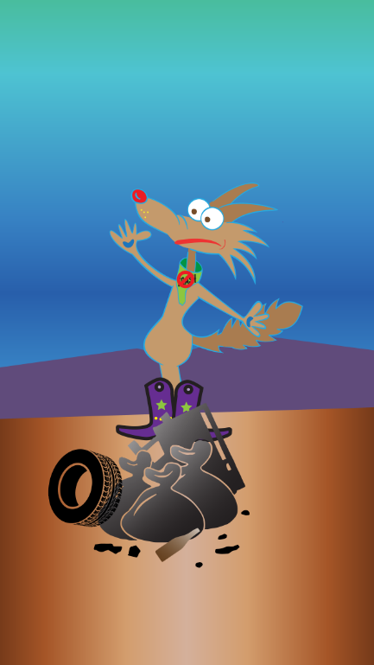
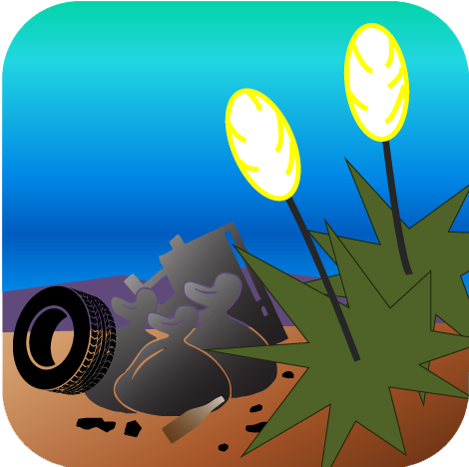
The New “NoThrow” App

Slide 7
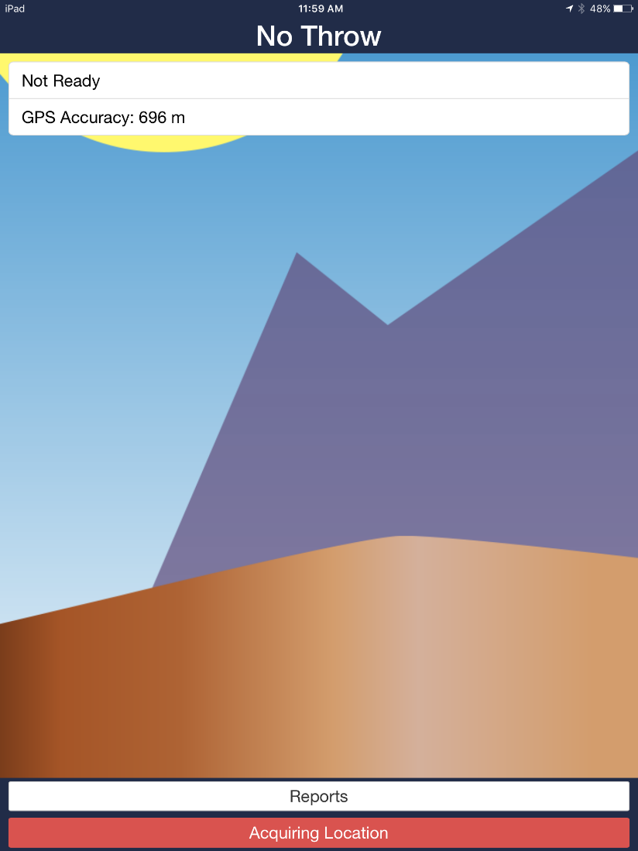

The New “NoThrow” App

Slide 8
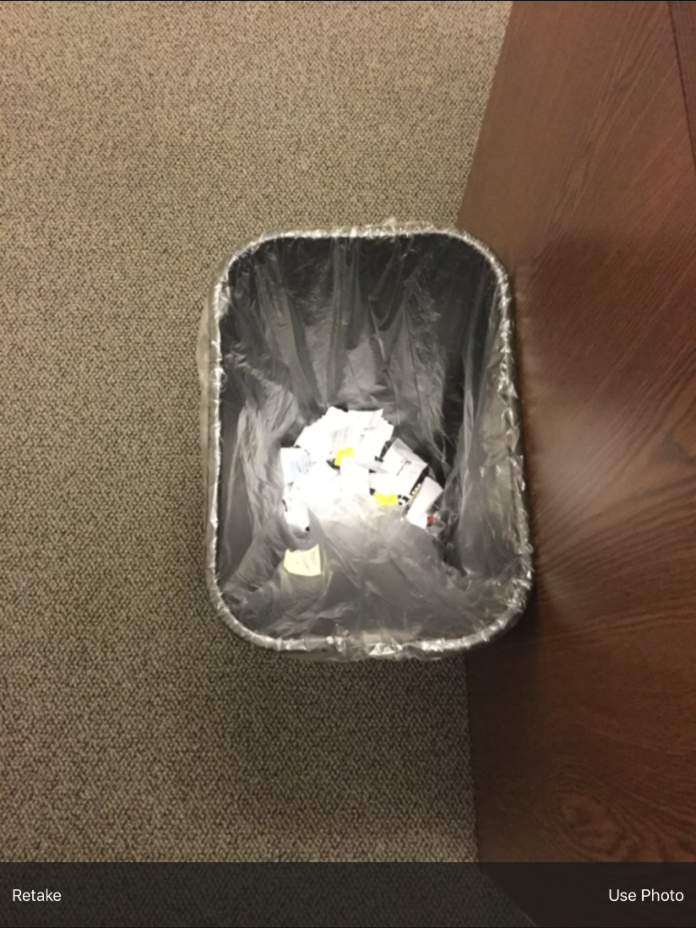
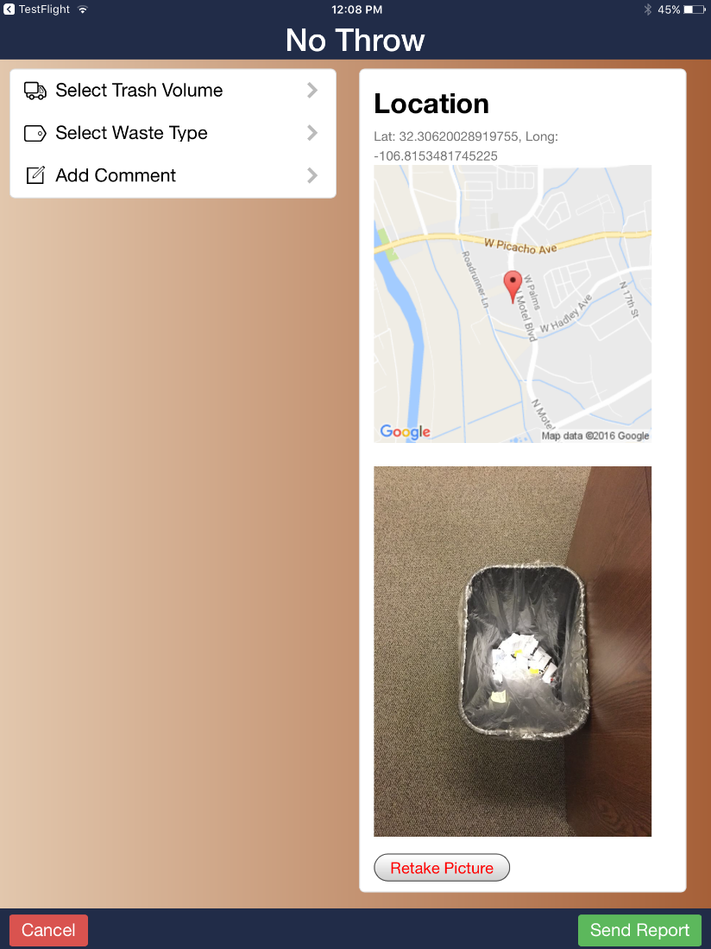
The New “NoThrow” App

Slide 9
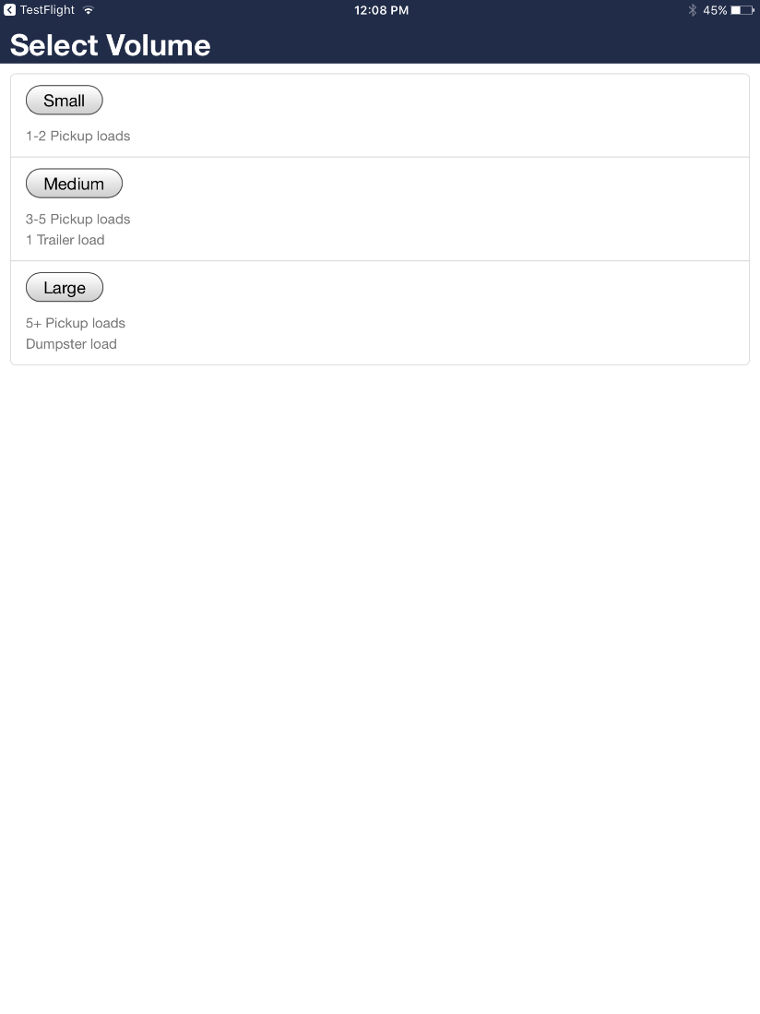
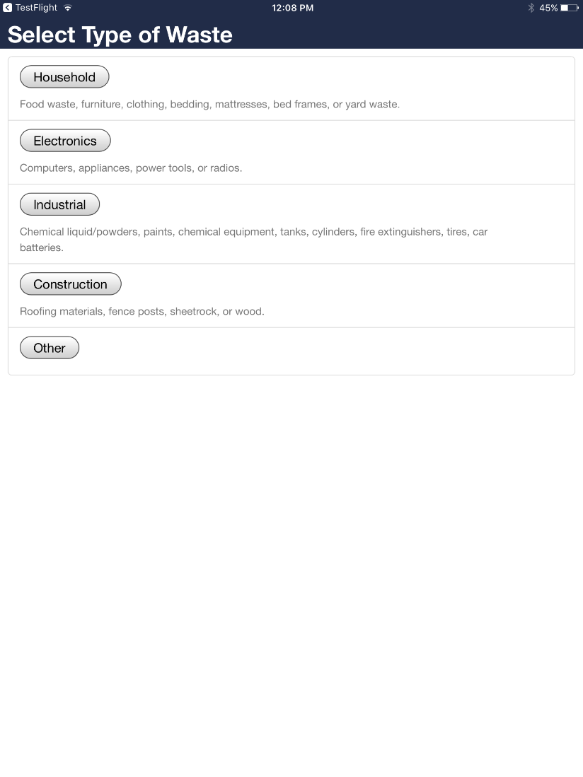
The New “NoThrow” App

Slide 10
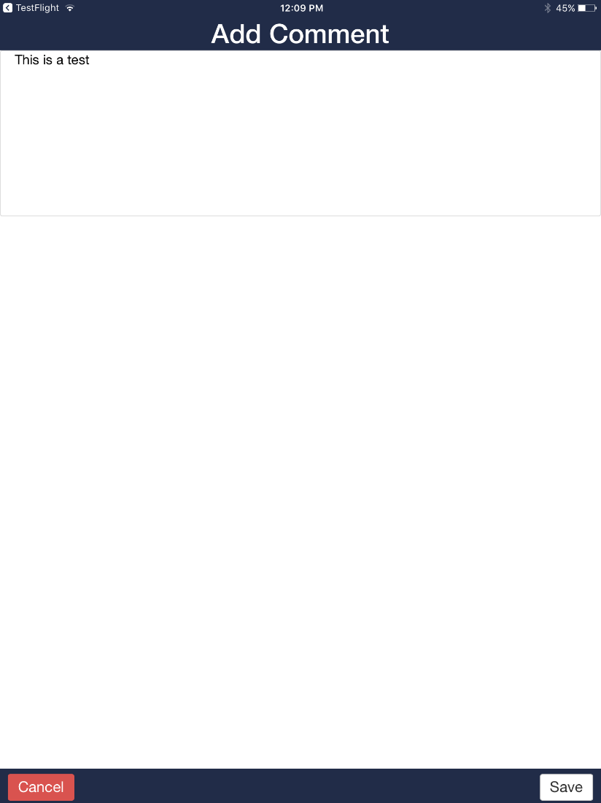
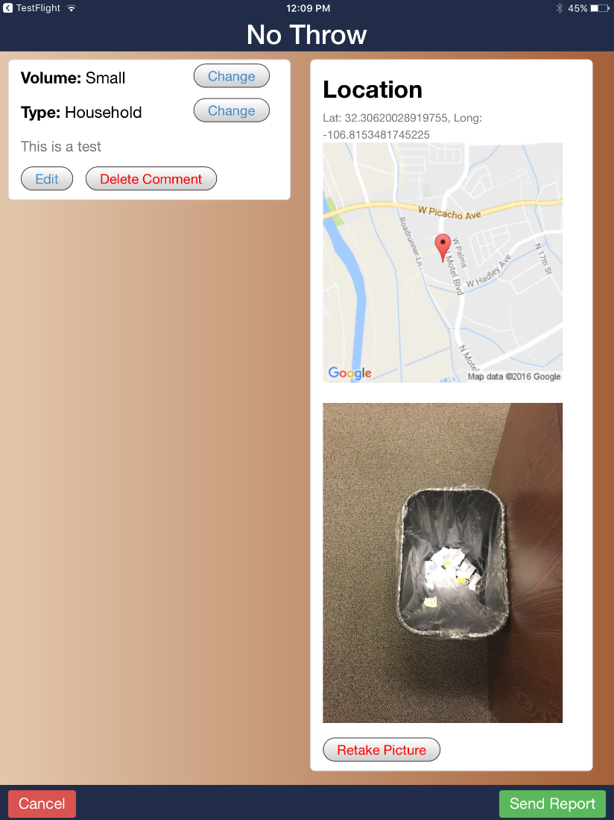
The New “NoThrow” App

Slide 11
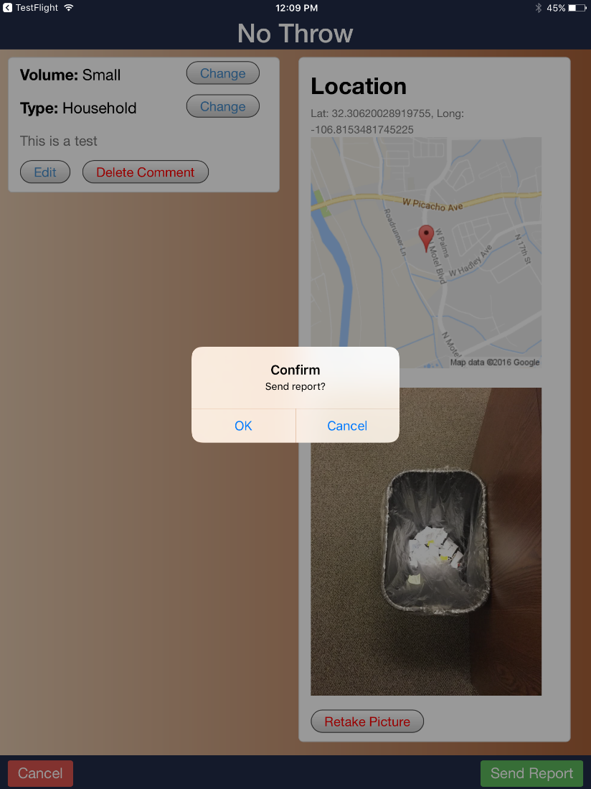
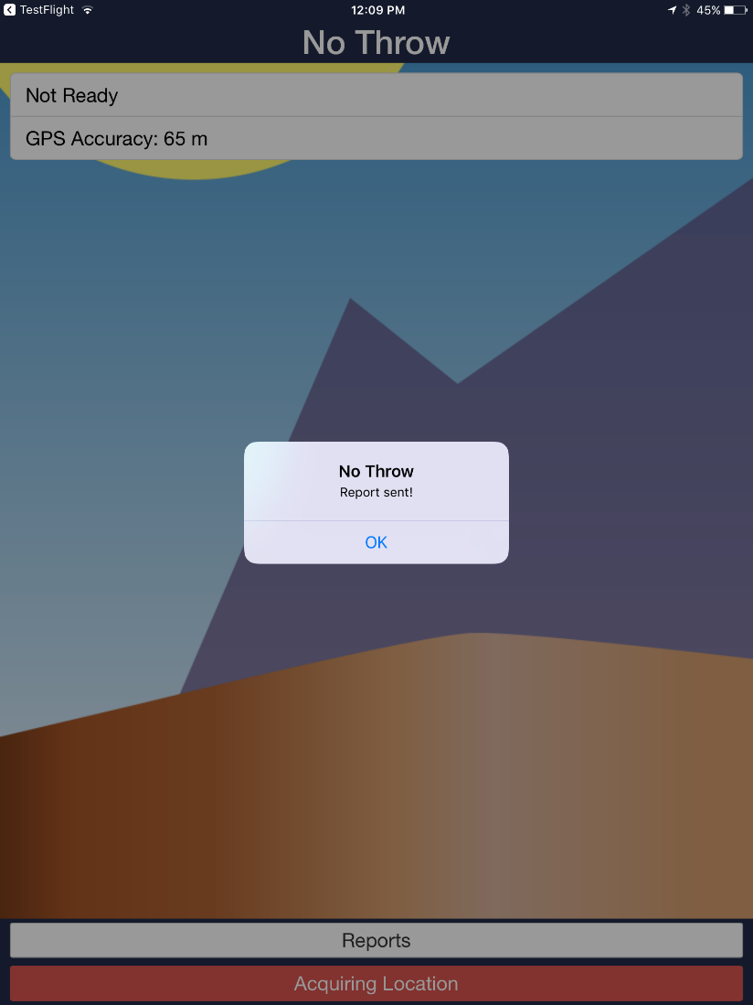
The New “NoThrow” App

Slide 12
Portability of Illegal Dumping Reporting System to Other Jurisdictions
No Throw Call Center not transferable to new jurisdiction via MVRDA, but process can be duplicated with help of MVRDA and Illegal Dumping Partnership to other 911 Dispatch.
Adopt use of 1-877-No-Throw number in other jurisdictions?
“NoThrow” App can be used and adopted anywhere. Require POC in new jurisdiction.
BLM establishing use of the “NoThrow” App at the State level in New Mexico.

Slide 13
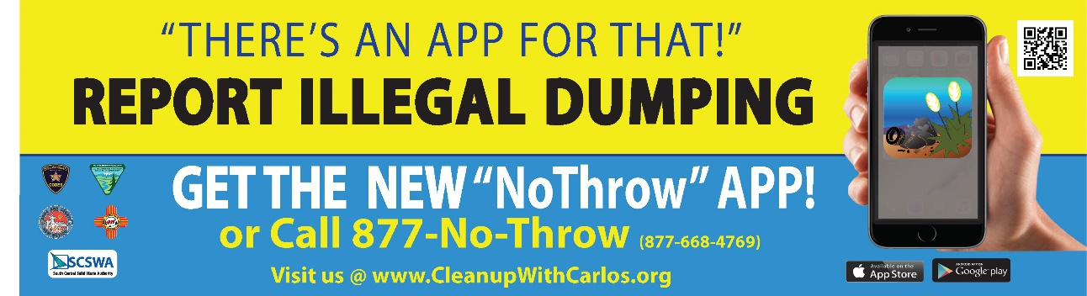
Advertising The “NoThrow” App
Importance on getting the word out about The “NoThrow” App and its availability to make it a successful endeavor.
Advertising Options: Bumper stickers, newspapers, radio spots, billboards and movie theater.
Other low-cost, creative options?

Slide 14
“NoThrow” Statistics
Statistics as of October 16, 2018
Number of Downloads of App: 911
Number of Reports Submitted Via App: 1,427
Number of Reports Through Call Center: 886
Number of Sites Cleaned: 924

