Slide 1
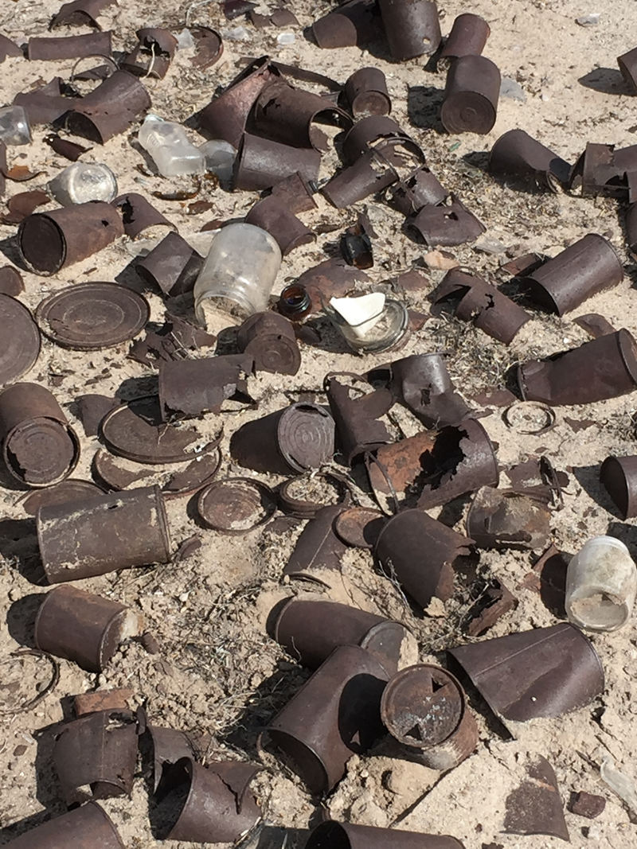
Illegal Dump Program
Rusty Stovall
Bureau of Land Management rstovall@blm.gov
(575) 525-4411

Slide 2
Mission
Improve the health, enjoyment, and quality of life for future generations of New Mexicans through ongoing efforts to eliminate illegal dumping on public lands.

Slide 3
Why did we create the Illegal Dump Program?

Slide 4
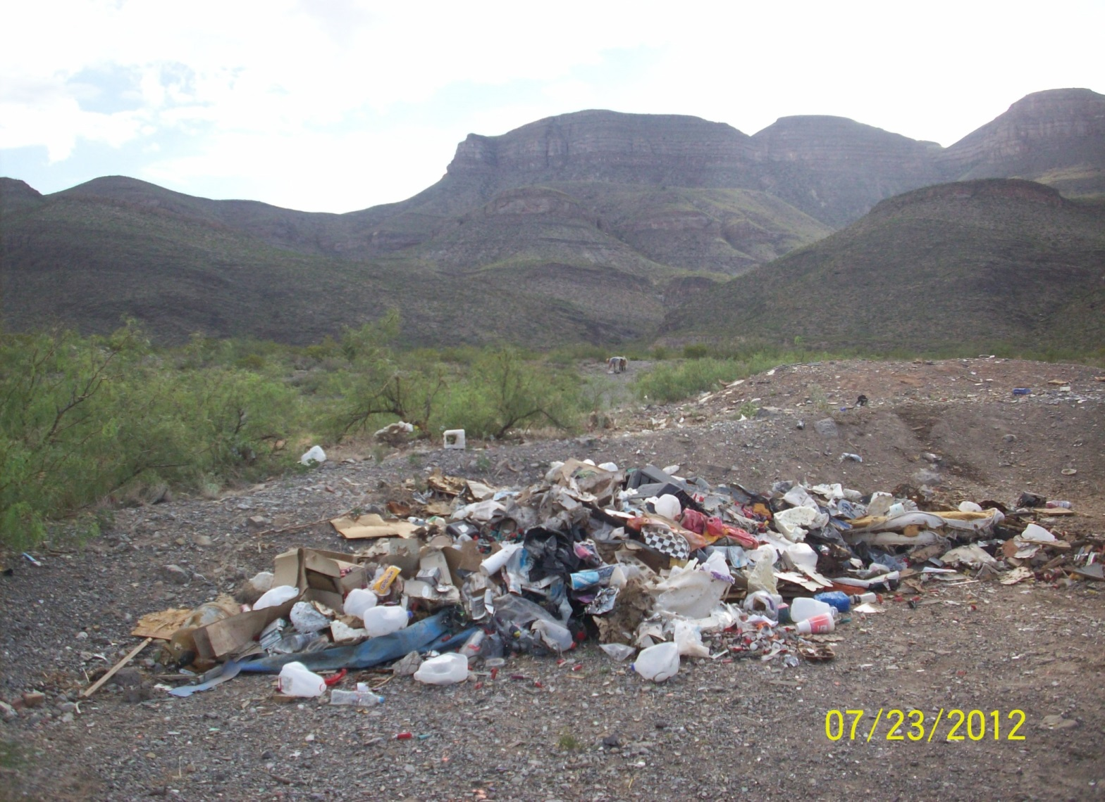

Slide 5
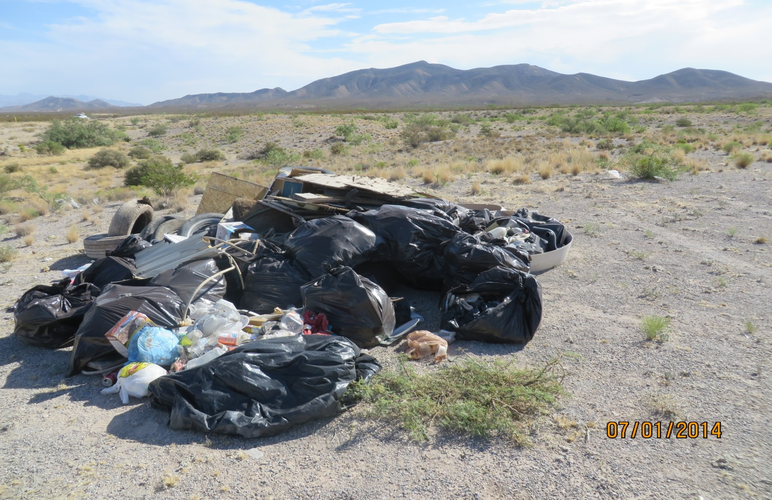

Slide 6
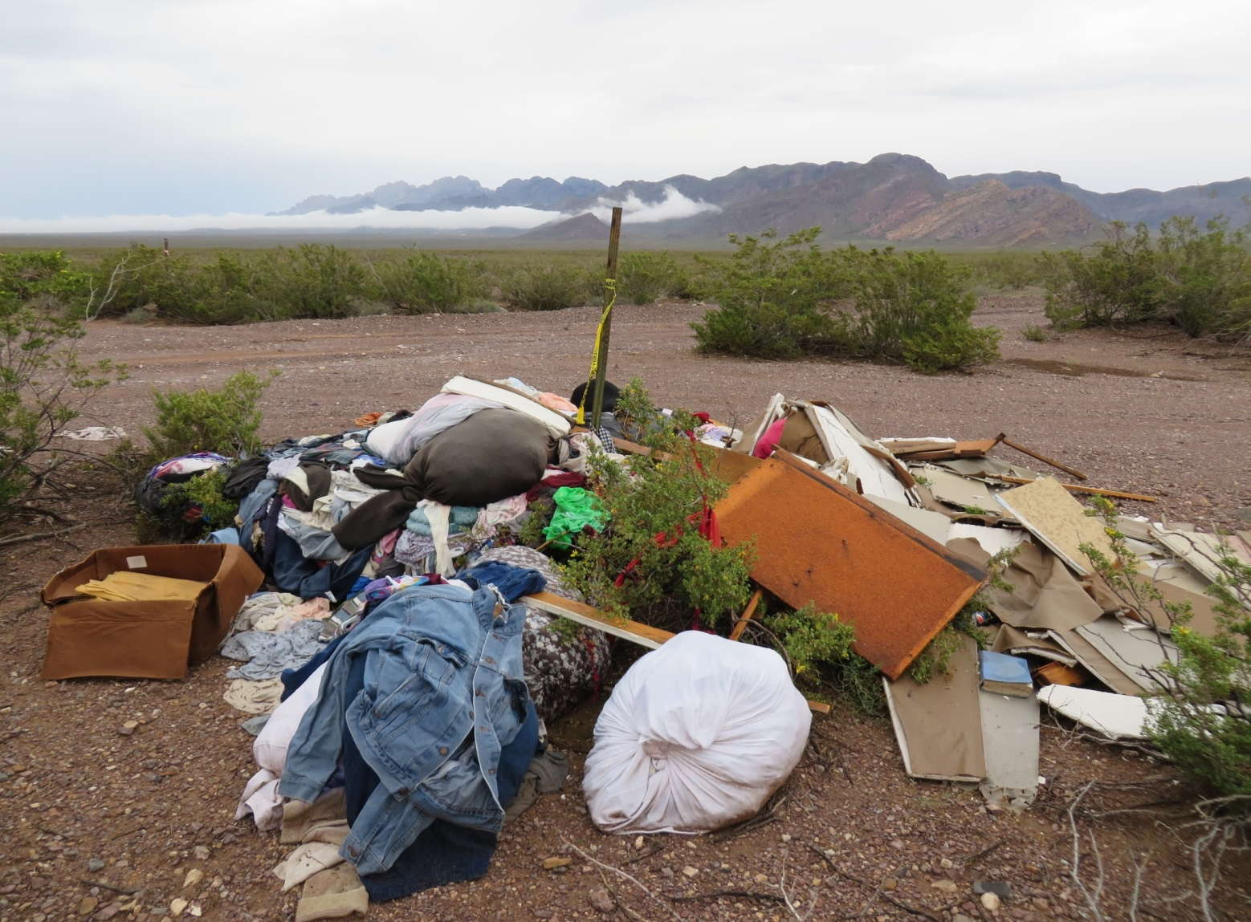

Slide 7
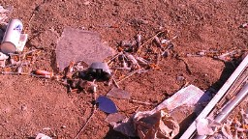
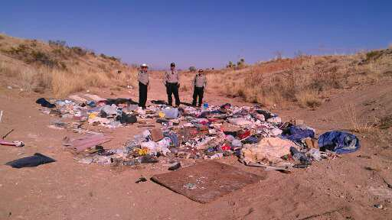
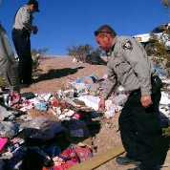
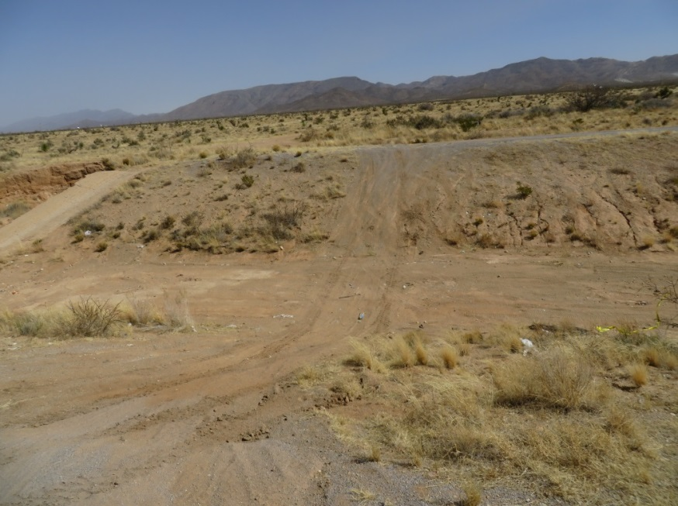

Slide 8
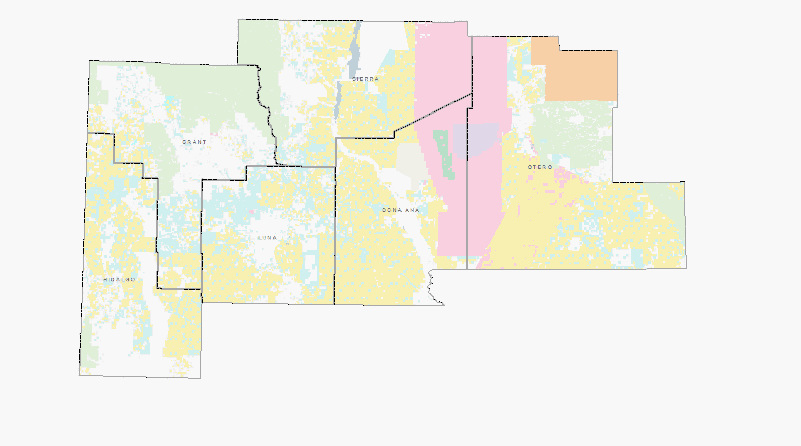
Illegal Dumping
A Growing Problem

Slide 9
Vision
We envision the elimination of illegal dumping on public land in the Las Cruces District Office. Through partnerships, shared resources, and education we can provide future generations with safe and beautiful land and renew public pride and ownership.

Slide 10
What are we doing to eliminate illegal dumping?
Partnerships
Visual adds
Educational outreach
Media
Community outreach
Student hires
Theater preview adds
Mobile application

Slide 11









Partnerships

Slide 12

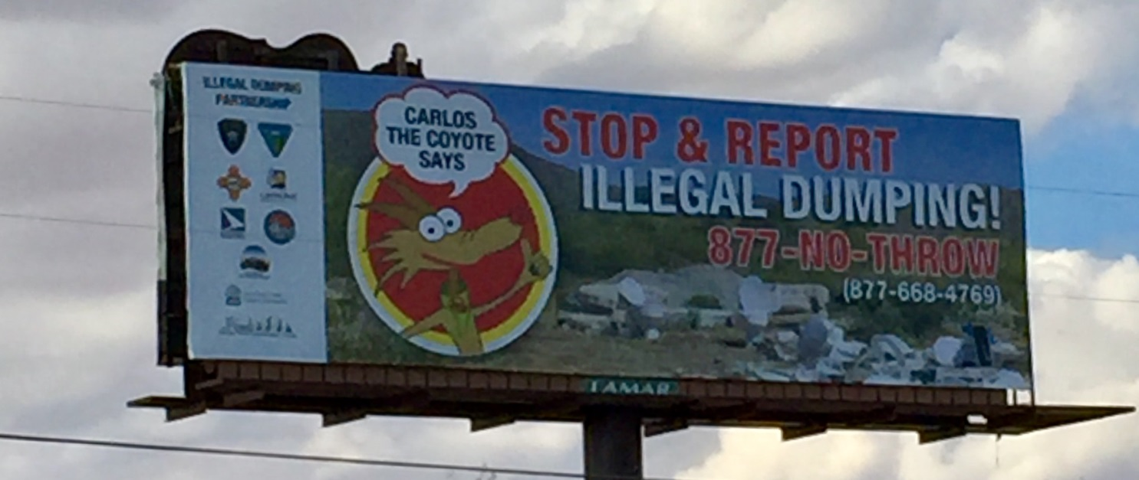
Bumper Stickers and Billboards

Slide 13
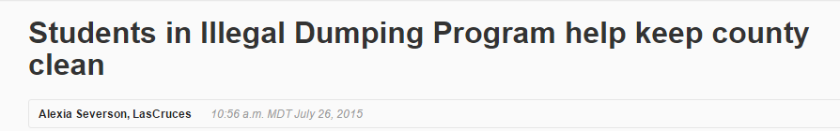

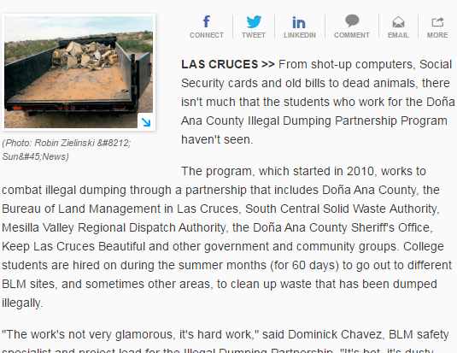
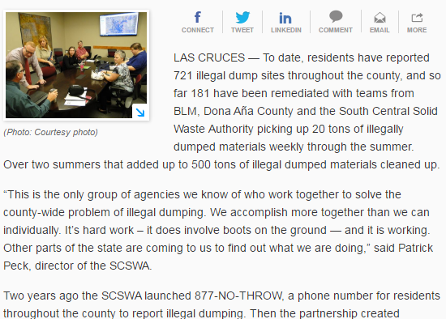
News Articles
Source:
http://www.lcsun-news.com/story/entertainment/local/sunlife/2015/07/26/students-illegal-dumping-program-help-keep-county-clean/32014115/
http://www.lcsun-news.com/story/news/local/2015/10/06/partnership-seeks-reduce-illegal-dumping/73469594/

Slide 14
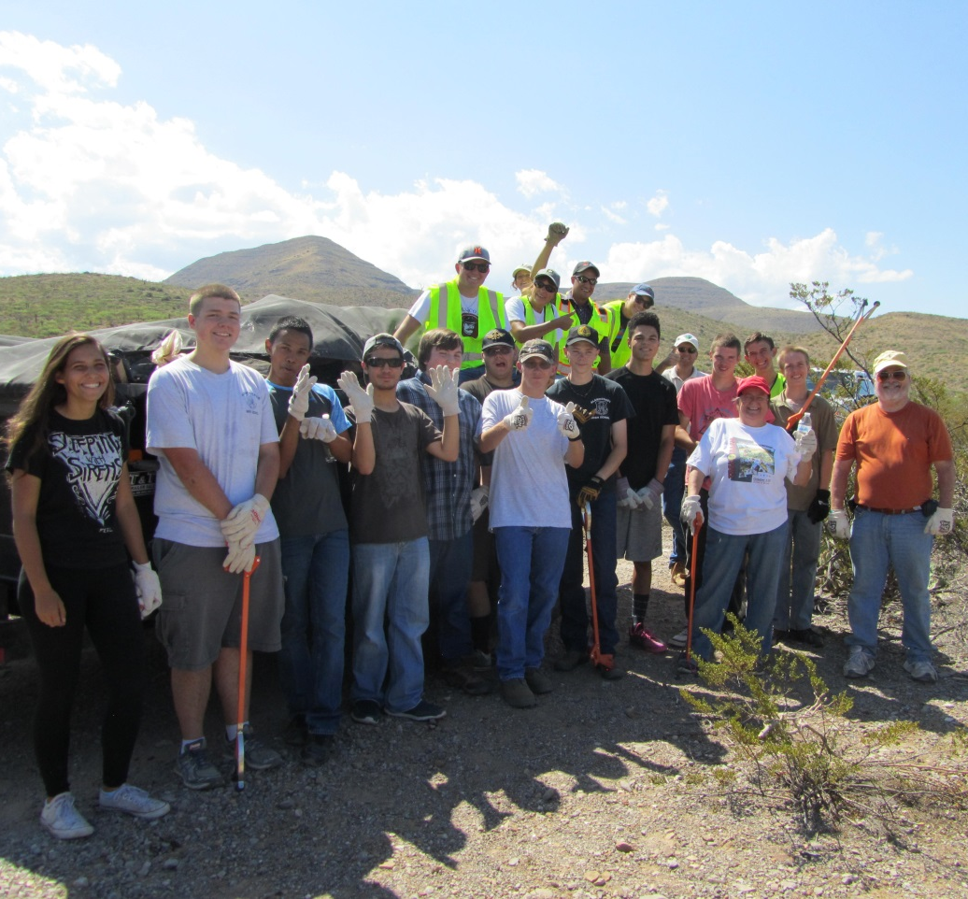
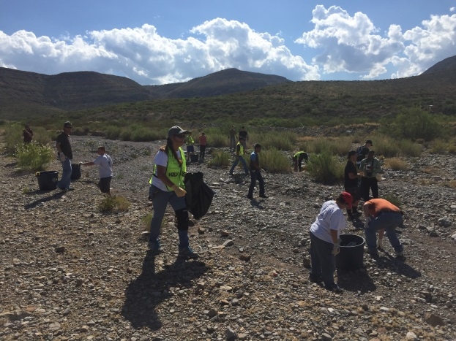
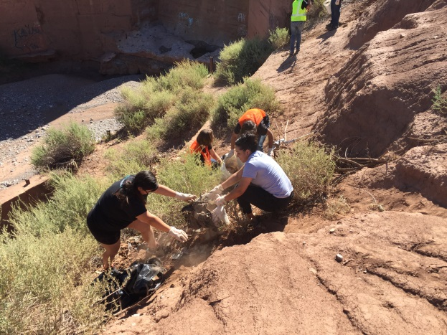
Community Outreach

Slide 15
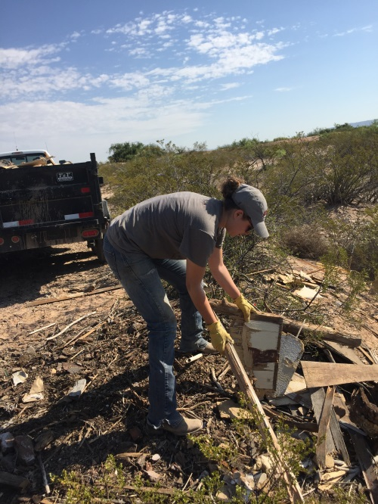
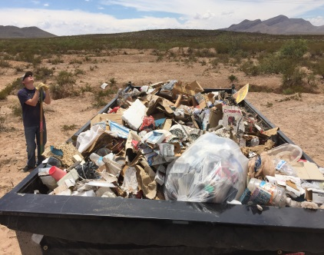
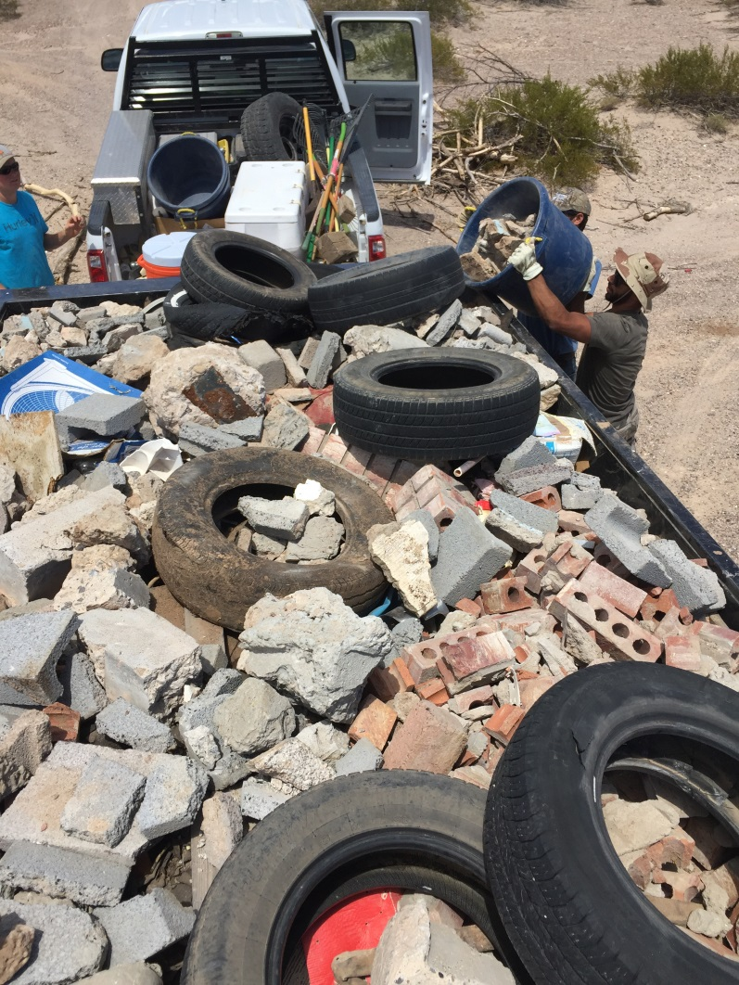
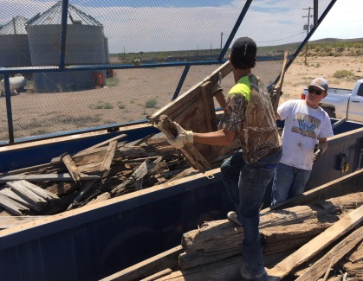
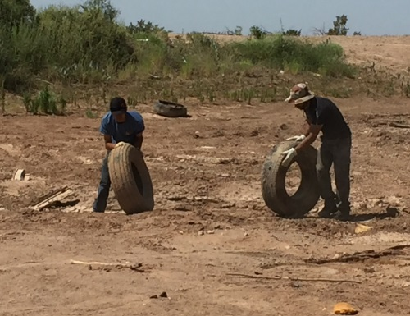
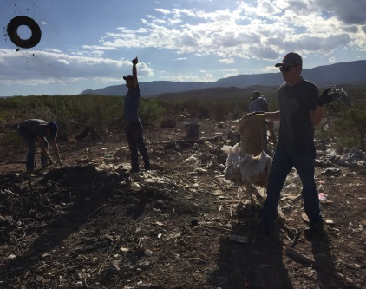
Student Hires

Slide 16
BLM Assistance Funds
YEAR | COUNTY | ASSISTANCE FUNDS | MATCHED/IN-KIND FUNDS | TOTAL
2012 | Dona Ana | $75,000 | $53,100 | $128,100
2013 | Dona Ana | $40,000 | $24,000 | $64,000
2014 | Dona Ana | $10,000 | $1,000 | $11,000
2014 | Dona Ana | $80,000 | $29,000 | $109,000
2014 | Otero | $25,000 | $5,085 | $30,085
2012 | Dona Ana | $40,000 | $24,000 | $64,000
2014 | Sierra | $20,000 | $2,000 | $22,000
2014 | Sierra | $7,000 | $1,000 | $8,000
2015 | Dona Ana | $15,000 | $0 | $15,000
2015 | Luna | $25,000 | $18,000 | $43,000
2016 | Dona Ana | $35,000 | $7,000 | $42,000
2016 | Luna | $60,000 | $18,000 | $78,000
2016 | Dona Ana | $15,000 | $22,500 | $37,500
TOTAL |  | $447,000 | $204,685 | $651,685
TOTAL BY COUNTY
 | COUNTY | ASSISTANCE FUNDS | MATCHED/IN-KIND FUNDS | TOTAL
 | Dona Ana | $310,000 | $160,600 | $470,600
 | Luna | $85,000 | $36,000 | $121,000
 | Otero | $25,000 | $5,085 | $30,085
 | Sierra | $27,000 | $3,000 | $30,000
TOTAL |  | $447,000 | $204,685 | $651,685

Slide 17
Reported costs from DAC Codes Illegal Dump Program from December 2015 through April 2016:
Labor - $23,505
Miles driven (10K) - $4,215
Tipping fees - $7,742
Truck, Trailer, PPE - $63,410
Total: $98,872
The Real Cost of Illegal Dumping
DAC Codes Case Study

Slide 18
Results
Over 3.5 million lbs.
of waste removed in less than 5 years!
BLM LCDO has cleared over 1362 tons, or 2,724,000 lbs. of solid waste from public land since 2012.
Doña Ana County/SCSWA has cleared 429 tons, or 858,000 lbs. of solid waste from public land since 2012.

Slide 19
What can the BLM do in 60 days?
In the summer of 2015, a five-member LCDO crew cleared over 500 tons of solid waste that remediated 220 individual illegal dump sites. In the Illegal Dump Program’s infancy, summer crews would clear an average 350 tons of solid waste that spanned 200 individual dump site locations.

Slide 20
What can you do in 60 days
Form a Partnership
Engage the Community
Find some Volunteers
Clean up 500 tons
Write a story for the News Paper
Apply for a grant?????
The answer is really up to You

